Slide 1

Introduction to AI ,ML and Deep Learning

Slide 2

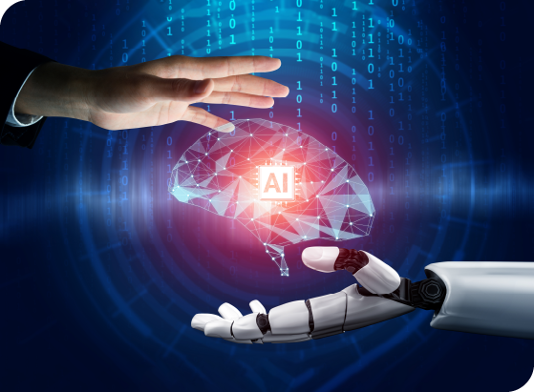
Agenda
Basics of AI, Machine Learning, and Deep Learning

Slide 3
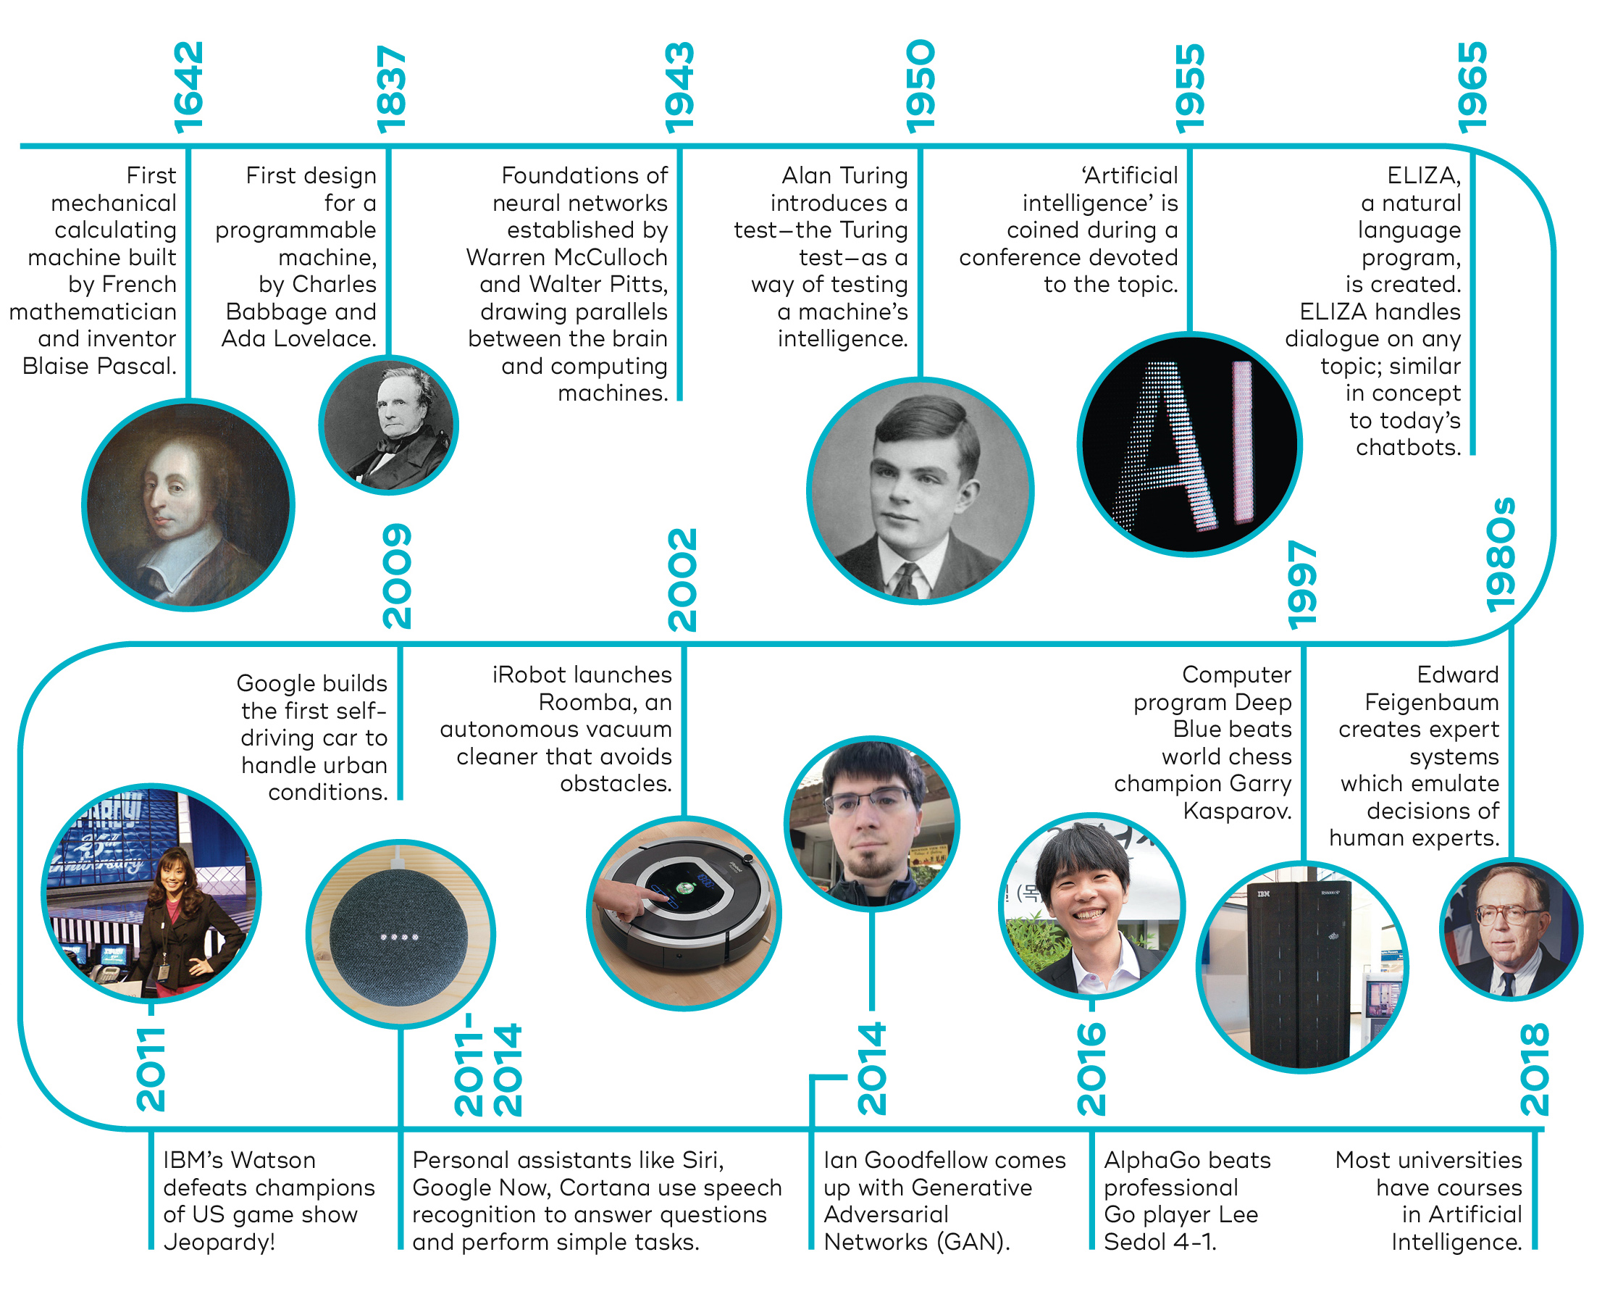
History of AI
Notes:
🧠 History of Artificial Intelligence (AI)
📌 1. The Early Foundations (Before 1950s)
Myth and Philosophy: Ancient myths of mechanical men and automata; philosophical ideas of logic and reasoning (Aristotle, Descartes).
Mathematical Logic: Work by George Boole, Gottfried Leibniz, and others laid the foundation for symbolic reasoning.
📌 2. Birth of AI (1950s)
Alan Turing (1950): Proposed the idea of a "thinking machine" and the famous Turing Test to assess machine intelligence.
1956 – Dartmouth Conference: Coined the term “Artificial Intelligence”. Organised by John McCarthy, Marvin Minsky, Nathaniel Rochester, and Claude Shannon.
📌 3. Early AI Programs (1950s–1960s)
Logic Theorist (1956) by Newell and Simon: First program to mimic human problem-solving.
General Problem Solver (1957): Early AI system for solving simple tasks.
AI research was funded well and expectations were high.
📌 4. The First AI Winter (1970s)
Progress slowed due to:
Limited computing power
High cost and over-promised results
Funding cuts caused reduced enthusiasm – known as the “AI Winter.”
📌 5. Revival Through Expert Systems (1980s)
Rise of Expert Systems (e.g., MYCIN for medical diagnosis):
Used rules to simulate expert knowledge.
Widely adopted in industry.
Renewed commercial interest and funding.
📌 6. The Second AI Winter (Late 1980s–1990s)
Expert systems became too expensive and rigid.
Interest declined again due to limitations in scalability and learning.
📌 7. Modern AI and Machine Learning (2000s–Present)
Data + Power = Breakthroughs:
Explosion of data (Big Data) and powerful GPUs.
Rise of Machine Learning, Deep Learning, and Neural Networks.
Major milestones:
IBM Watson wins Jeopardy! (2011)
AlphaGo defeats world Go champion (2016)
Widespread use in self-driving cars, virtual assistants, healthcare, finance etc.
📌 8. Today and the Future
Generative AI (e.g., ChatGPT, DALL·E) changes how humans interact with machines.
Ethical concerns, regulations, and AI safety are becoming central topics.
Continued research in AGI (Artificial General Intelligence).

Slide 4
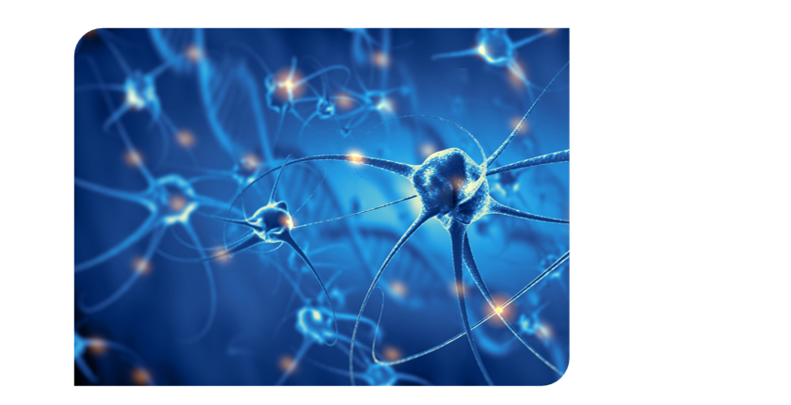
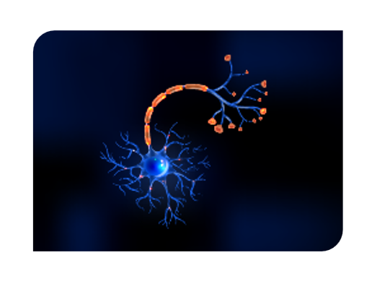
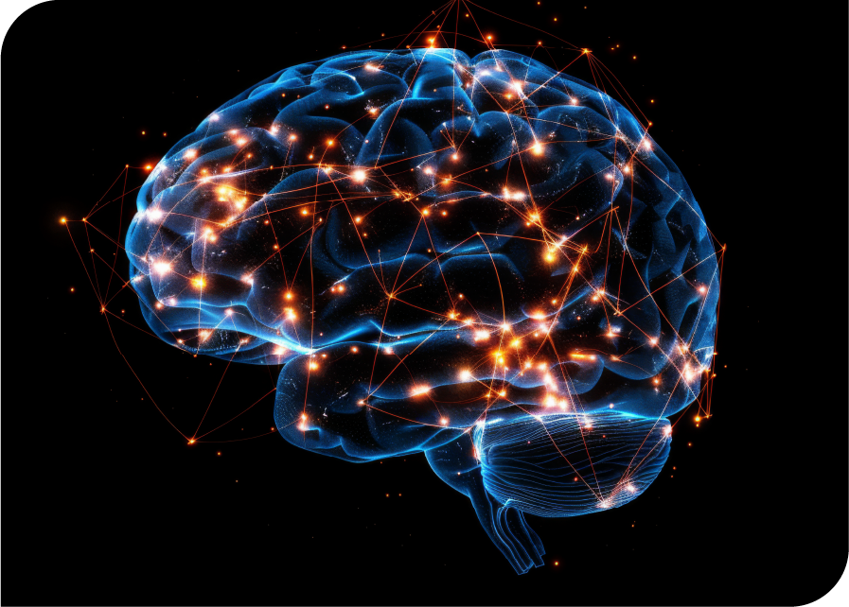
Working of Human Brain
Brain
Neural network
Neuron

Slide 5
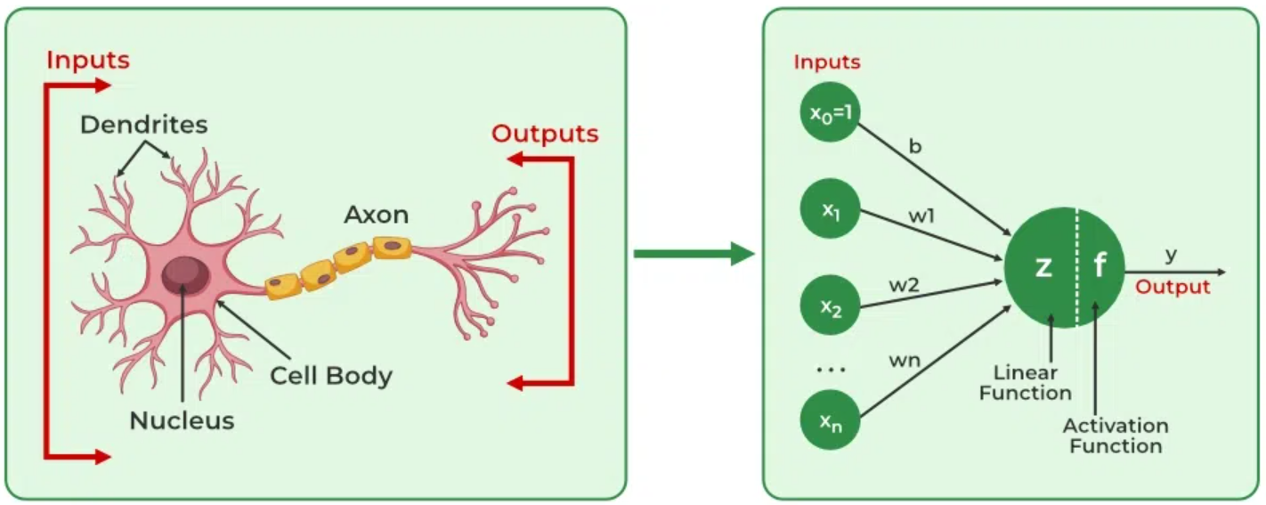
Artificial Neural Networks
Biological Neuron
Artificial Neuron
Notes:
🧠 Biological Neuron vs Artificial Neuron – Notes
🔬 1. Biological Neuron
Basic unit of the human brain and nervous system.
Specialised cell that transmits electrical and chemical signals.
Consists of:
Dendrites – Receive signals from other neurons.
Cell Body (Soma) – Processes incoming signals.
Axon – Sends output signals to other neurons.
Synapse – Junction where signals are transmitted between neurons.
Signal is triggered when a threshold is reached.
Learns by synaptic plasticity – strength of connections changes with experience.
Works slowly (in milliseconds) but is highly energy efficient.
Enables functions like perception, movement, and decision-making.
🤖 2. Artificial Neuron (Perceptron)
Simplified mathematical model inspired by the biological neuron.
Used in Artificial Neural Networks (ANNs).
Structure includes:
Inputs (features) – Represent data values.
Weights – Indicate the importance of each input.
Summation Function – Calculates weighted sum of inputs.
Activation Function – Determines output based on the sum (e.g., Sigmoid, ReLU).
Fires (produces an output) when the sum crosses a threshold.
Learns by adjusting weights using algorithms like Gradient Descent.
Much faster than biological neurons, but consumes more computational power.
Used for tasks like image recognition, speech processing, and predictions.

Slide 6
What is Artificial Intelligence?
Artificial Intelligence
Artificial Intelligence refers to creating intelligent machines that mimic human-like abilities using wide range of techniques, algorithms, and methodologies aimed to perform tasks that typically requires human intelligence.
Example – A Chess application designed to play
with humans with set of rules
Machine Learning
Deep learning
Generative AI

Slide 7
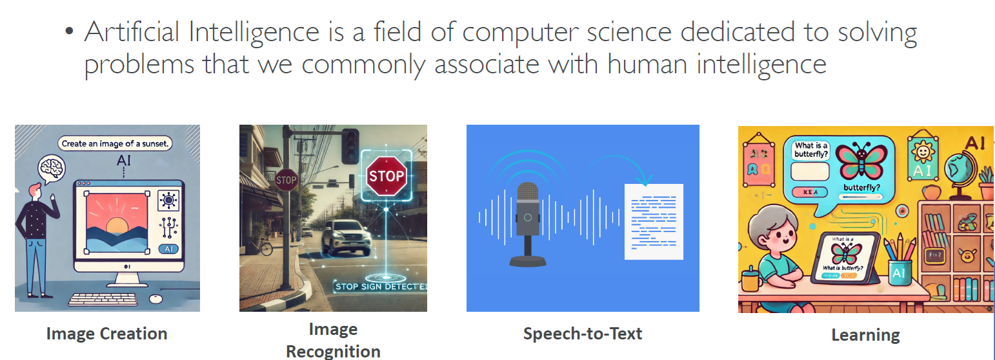
Artificial Intelligence?

Slide 8
Examples of Artificial Intelligence in Daily Life
Virtual Assistants – Siri, Alexa, Google Assistant (respond to voice commands)
Recommendation Systems – Netflix, YouTube, Amazon (suggest content/products)
Email Filters – Gmail spam detection using AI
Navigation Apps – Google Maps, Waze (real-time traffic prediction)
Facial Recognition – Face ID on smartphones, security systems
Chatbots – Used in customer support for instant replies
Self-driving Cars – AI controls steering, braking, and navigation
Language Translation – Google Translate, Microsoft Translator

Slide 9
Examples of Artificial Intelligence in Daily Life
Virtual Assistants – Siri, Alexa, Google Assistant (respond to voice commands)
Recommendation Systems – Netflix, YouTube, Amazon (suggest content/products)
Email Filters – Gmail spam detection using AI
Navigation Apps – Google Maps, Waze (real-time traffic prediction)
Facial Recognition – Face ID on smartphones, security systems
Chatbots – Used in customer support for instant replies
Self-driving Cars – AI controls steering, braking, and navigation
Language Translation – Google Translate, Microsoft Translator

Slide 10
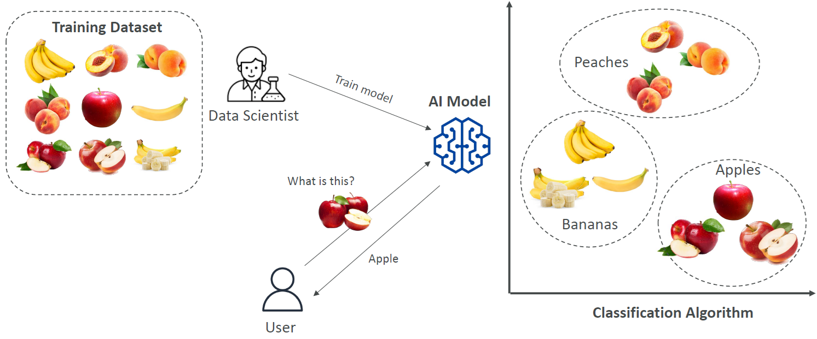
How does AI Work ?

Slide 11
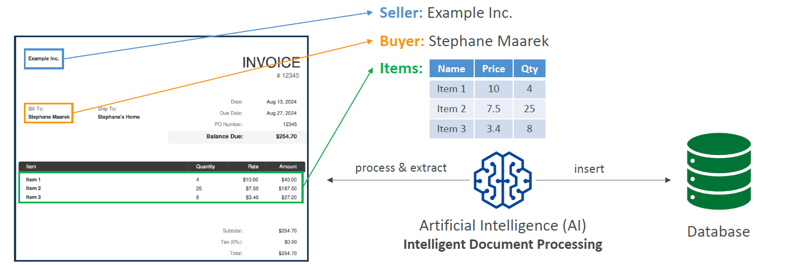
AI Example: Intelligent Document Processing

Slide 12
What is Machine Learning?
Machine Learning is a subset of AI that unlike using
human defined rules, it gain insights from data automatically and identify patterns to make future prediction based on many features that a human may not be able to discover.
Example – A Chess application that will play with humans and learn how to win.
Artificial Intelligence
Artificial Intelligence
Machine Learning
Machine Learning
Deep learning
Deep learning
Generative AI
Generative AI

Slide 13
Examples of Machine Learning in Real Life
Spam Detection – Email services use ML to filter spam vs. important messages
Product Recommendations – Amazon, Flipkart suggest products based on user behaviour
Voice Recognition – ML powers Siri, Alexa, and Google Assistant
Fraud Detection – Banks use ML to detect unusual transactions
Predictive Text – Keyboard apps suggest next words as you type
Medical Diagnosis – ML helps in detecting diseases like cancer from scans
Customer Segmentation – Businesses use ML to target marketing campaigns
Stock Market Forecasting – ML models predict price trends and risks

Slide 14
What is Deep Learning?
Artificial Intelligence
Deep Learning is a subset of ML which learns complex patterns and relationship between data using Artificial Neural Network (ANN).
Example – A Chess application that will play with itself to learn how to win.
Machine Learning
Deep learning
Generative AI

Slide 15
Examples of Deep Learning in Real Life
Image Recognition – Facebook auto-tags friends in photos
Voice Assistants – Siri and Alexa understand speech using deep learning
Self-Driving Cars – Tesla uses deep learning to detect objects, lanes, and pedestrians
Language Translation – Google Translate uses deep neural networks for accurate translation
Facial Recognition – Used in security systems and smartphone unlocking
Healthcare Diagnostics – Detects diseases like cancer from X-rays and MRIs
Deepfake Technology – Creates realistic fake images and videos
Chatbots and Virtual Agents – Generate human-like responses in customer service

Slide 16
Thank You!

